Slide 1

Programming Fundamentals
By
Dr Suhail Asghar
Dawood University Of Engineering & Technology Karachi

Slide 2
Arrays
Arrays are one dimensional, two-dimensional etc.
Consecutive/contiguous group of memory locations
Same name and type (int, char, float etc.)
Student_Names[50], Student_GPA[50], Dept_Names[10]
Compiler reserves a memory section to hold all of data
The lowest address corresponds to the first element
The highest address to the last element
To refer to an element
Specify array name and position number (index)
Format: arrayname [ position number ]
First element at position 0 (index 0)
Last element at position N-1 (index N-1)
10-element array c
c[ 0 ], c[ 1 ] … c[ 9 ]

Slide 3
Declaring Arrays
When declaring arrays, specify
Name
Type of an array
Any data type
Number of elements/Size of an array
type arrayName[ arraySize ];
int c[ 10 ]; // array of 10 integers
float d[ 3284 ]; // array of 3284 floats
Declaring multiple arrays of same type
Use comma separated list, like regular variables
int b[ 100 ], x[ 27 ];

Slide 4
Initializing arrays
For loop
Set each element
Initializer list
Specify each element when array declared
int n[ 5 ] = { 1, 2, 3, 4, 5 };
If not enough initializers, rightmost elements 0
If too many syntax error
To assign value to every element individually
int A[3];
A [0] = 2; A [1] = 12; A[2] = 1;
If array size omitted, initializers determine size
int n[] = { 1, 2, 3, 4, 5 };
5 initializers, therefore 5 element array

Slide 5
Examples Using Arrays
Accessing Array elements
Values of any of elements in an array can be accessed
Arrayname [index]
n[0], n[1], student_name[5], vowel[3], course_name[1] etc.
Variable1=vowel[3];
x=n[0]+n[1];
#include <iostream>
using namespace std;
int num_array [] = {15, 30, 75, 40, 120};
int i, result=0;
int main ()
{
for ( i=0 ; i<5 ; i++ )
{
result += num_array[i];
}
cout << result;
return 0; }

Slide 6
Examples Using Arrays
Array size
Can be specified with constant variable (const)
const int size = 20;
Constants cannot be changed
Constants must be initialized when declared
Also called named constants or read-only variables

Slide 7
Write a C++ program that takes the number of elements as input, stores the user-entered values in an array, and then prints the array elements
#include <iostream>
using namespace std;
int main() {
int n;
cout << "How many elements do you want to enter? ";
cin >> n;
int arr[n];
cout << "Enter " << n << " elements:\n";
for(int i = 0; i < n; i++) {
cin >> arr[i];
}
cout << "You entered:\n";
for(int i = 0; i < n; i++) {
cout << arr[i] << " ";
}
return 0;
}

Slide 8
Accessing Array elements
Values of any of elements in an array can be accessed
Arrayname [index]
n[0], n[1], student_name[5], vowel[3], course_name[1] etc.
Variable1=vowel[3];
x=n[0]+n[1];
#include <iostream>
using namespace std;
int num_array [] = {15, 30, 75, 40, 120};
int i, result=0;
int main () {
for ( i=0 ; i<5 ; i++ )
{
result += num_array[i];
}
cout << result;
return 0; }

Slide 9
Write a C++ program that prints a horizontal histogram of the array
#include <iostream>
using namespace std;
int main() {
int var = 10;
int arr[var] = {19, 3, 15, 7, 11, 9, 13, 5, 17, 1};
for (int i = 0; i < var; i++) {
for (int j = 0; j < arr[i]; j++) {
cout << "*";
}
cout << endl;
}
return 0;
}

Slide 10
Write a C++ program that prints a horizontal histogram of the array (all input)
#include <iostream>
using namespace std;
int main() {
int var;
cout <<"How many parameters are there"<<endl;
cin>>var;
int arr[var];
cout <<"Enter values corresponding to the variables"<<endl;
for (int i = 0; i < var; i++)
cin>> arr[i];
for (int i = 0; i < var; i++) {
for (int j = 0; j < arr[i]; j++) {
cout << "*";
}
cout << endl;
}
return 0;
}

Slide 11
Examples Using Arrays
1
2
3 #include <iostream>
4
5 using std::cout;
6 using std::endl;
7
8 #include <iomanip>
9
10 using std::setw;
11
12 int main()
13 {
14 int n[ 10 ]; // n is an array of 10 integers
15
16 // initialize elements of array n to 0
17 for ( int i = 0; i < 10; i++ )
18 n[ i ] = 0; // set element at location i to 0
19
20 cout << "Element" << setw( 13 ) << "Value" << endl;
21
22 // output contents of array n in tabular format
23 for ( int j = 0; j < 10; j++ )
24 cout << setw( 7 ) << j << setw( 13 ) << n[ j ] << endl;
Declare a 10-element array of integers.
Initialize array to 0 using a for loop. Note that the array has elements n[0] to n[9].

Slide 12
Examples Using Arrays
26 return 0; // indicates successful termination
27
28 } // end main
Element Value
0 0
1 0
2 0
3 0
4 0
5 0
6 0
7 0
8 0
9 0

Slide 13
Write a C++ program that takes an array of numbers as input and sorts it in ascending order.
#include <iostream>
using namespace std;
int main()
{
const int ARRAY_SIZE=5;
int array1[ARRAY_SIZE], i ,j ,temp;
cout<<"Program for Sorting an Array in Asending Order\n";
// Input Array Elements
for (i = 0; i < ARRAY_SIZE; i++)
{
cout<<"Enter the Number : "<< i <<" : ";
cin>>array1[i]; }
cout<<endl;
// Display Elements of Unsorted Array
cout<<"UnSorted Array: ";
for (i = 0; i < ARRAY_SIZE; ++i)
cout<<array1[i]<<" ";
cout<<endl;

Slide 14
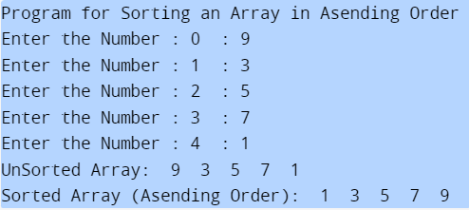
// Array Sorting - Asensding Order
for (i = 0; i < ARRAY_SIZE; ++i)
{
for (j = i + 1; j < ARRAY_SIZE; ++j)
{
if (array1[i] > array1[j])
{
temp = array1[i];
array1[i] = array1[j];
array1[j] = temp;
}
}
}
cout<<"Sorted Array (Asending Order): ";
for (i = 0; i < ARRAY_SIZE; ++i)
cout<<array1[i]<<" ";
return 0;
}

Slide 15
Multi-dimensional Array
Two-dimensional array (2D) represents information arranged in rows and columns (i.e., subscripts)
To identify a particular table element, we must specify two subscripts—by convention, the first identifies the element’s row and the second identifies the element’s column
Arrays with two or more dimensions are known as multidimensional arrays and can have more than two dimensions

Slide 16
Multi-dimensional Array
“Array of arrays”
In general, an array with m rows and n columns is called an m-by-n array
e.g. 2D array with 3 rows & 4 columns (3x4) array
an element name of the form a[ i ][ j ]

Slide 17
Multi-dimensional Array
To initialize
Default of 0
Initializers grouped by row in braces
int b[ 2 ][ 2 ] = { { 1, 2 }, { 3, 4 } };
int b[ 2 ][ 2 ] = { { 1 }, { 3, 4 } };
1 2
3 4
Row 0
Row 1
0
3 4

Slide 18
Multi-dimensional Array
#include<iostream>
using namespace std;
int main( ) {
int s[2][2];
int i, j;
cout<<"\n2D Array Input:\n";
for(i=0;i<2;i++)
{
for(j=0;j<2;j++)
{
cout<<"\ns["<<i<<"]["<<j<<"]= ";
cin>>s[i][j];
}
}
cout<<"\nThe 2-D Array is:\n";
for(i=0;i<2;i++)
{
for(j=0;j<2;j++)
{ cout<<"\t"<<s[i][j]; }
cout<<endl; }
return 0; }

Slide 19
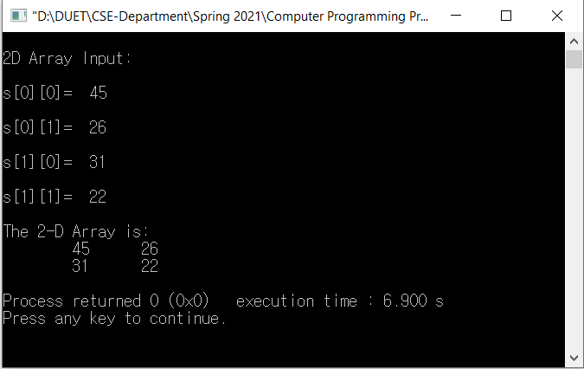
Multi-dimensional Array

Slide 20
Write a C++ program that takes marks of students in multiple courses, stores them in a 2D array, calculates each student's average, and displays the results.
#include <iostream>
using namespace std;
int main() {
const int students = 3;
const int courses = 3;
float marks[students][courses], average[students];
for (int i = 0; i < students; i++) {
float total = 0;
cout << "Enter marks for Student " << i + 1 << ":\n"; for (int j = 0; j < courses; j++) {
cin >> marks[i][j];
total += marks[i][j]; }
average[i] = total / courses; }
cout << "\nAverage marks of students:\n";
for (int i = 0; i < students; i++) {
cout << "Student " << i + 1 << ": " << average[i] << "\n"; } return 0;}

Slide 21
Array Container (STL)
Array can be created using array template
array <type, size> arrayname;
E.g. array <int, 10> array_using_template
The elements of an array also can be initialized in the array declaration by list of initializers
array< int, 5 > n = { 32, 27, 64, 18, 95 };
If there are fewer initializers than array elements, the remaining array elements are initialized to zero
array <int, 5>n= {3, 4, 5}
If the array size and an initializer list are specified in an array declaration, the number of initializers must be less than or equal to the array size
array <int, 5>n= {3, 4, 5, 6, 7, 8}

Slide 22
Array Container (STL)
#include <iostream>
#include<iomanip>
#include<array>
using namespace std;
int main()
{
array<int, 5>n={10, 50, 40, 35, 15};
cout<<"Element"<< setw(13) << "Value"<<endl;
for (int i=0; i<5; i++)
cout<<setw(7)<<i<<setw(13)<<n[i]<<endl;
return 0;
}

Slide 23
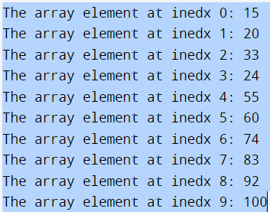
Array Container (STL)
#include <iostream>
#include <array>
using namespace std;
int main ()
{
array<int,10> array1={15,20,33,24,55,60,74,83,92,100};
for (int i=0; i<10;i++){
//at(n) function returns the value at that index
cout <<"The array element at inedx "<<i<<": "<<
array1.at(i)<<endl;
}
return 0;
}

Slide 24
Write a C++ program that uses std::array and sort() to sort an integer array and a character array, then prints each sorted element with its index.
#include <iostream>
#include <array>
#include <algorithm> // contains sort and binary_search
using namespace std;
int main () {
array<int,10> array1 = {150,200,303,24,55,60,87,38,15,100};
sort(array1.begin(), array1.end());
cout<<"Frist Array Sorting"<<endl;
for (int i=0; i<10;i++){
//at(n) function returns the value at that index
cout <<"The array element at inedx"<<i<<": "<<array1.at(i)<<endl;
}
cout<<"Second Array Sorting"<<endl;
array<char,6> array2={'R','A','M','E','S', 'H'};
sort(array2.begin(), array2.end());
for (int j=0; j<6;j++){
//at(n) function returns the value at that index
cout <<"The array element at inedx"<<j<<": "<<array2.at(j)<<endl;
}
return 0;
}

Slide 25
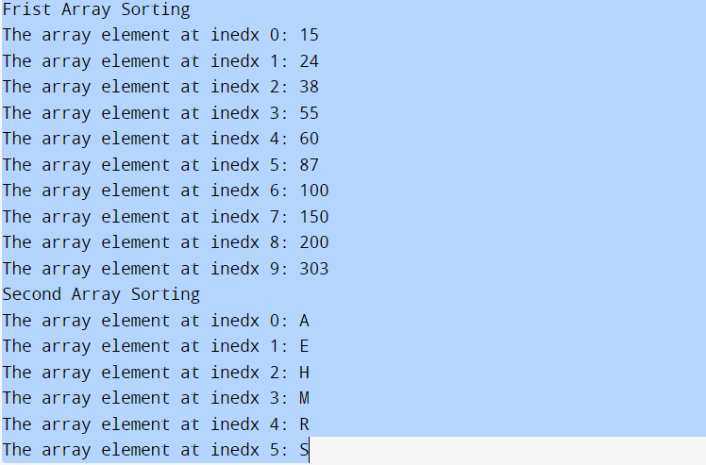

Slide 26
Write a C++ program that stores color names in a std::array, displays them unsorted, sorts them alphabetically, prints the sorted list, and uses binary_search to check for specific colors.
#include <array>
#include <string>
#include <algorithm> // contains sort and binary_search
using namespace std;
int main()
{
const size_t arraySize = 7; // size of array colors
array< string, arraySize > colors = { "red", "orange", "yellow", "green", "blue", "indigo", "violet" };
// output original array
cout << "Unsorted array: \n";
for ( string color : colors )
cout << color << " ";
sort(colors.begin(),colors.end()); //sort contents of colors
// output sorted array
cout << "\nSorted array: \n";
for ( string item : colors )
cout << item << " ";

Slide 27
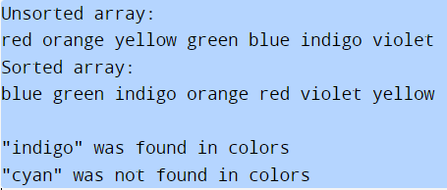
// search for "indigo" in colors
bool found= binary_search(colors.begin(),colors.end(),"indigo");
cout << "\n\n\"indigo\" " << ( found ? "was" : "was not" )<< " found in colors" << endl;
// search for "cyan" in colors
found = binary_search( colors.begin(), colors.end(), "cyan" );
cout << "\"cyan\" " << ( found ? "was" : "was not" )<< " found in colors" << endl;
return 0;
}

Slide 28
Dynamically Allocated Array
Static array limitations: (Compile-time size)
Must specify size first as a constant
Array elements are stored on the stack
Very limited application, as in many cases the number of elements may not be known until the program runs
May use partially filled arrays for more flexibility
Must estimate maximum size needed
Wastes memory
Dynamic arrays: (Run-time size)
Can grow and shrink as needed
Implemented as a pointer to a dynamically allocated array
Array elements are stored on the heap

Slide 29
Dynamically Allocated Array STL template vector
STL class template vector is similar to class template array, but also supports dynamic resizing
Dynamically grow to accommodate more elements
Standard class template vector is defined in header <vector> and belongs to namespace std.
vectors can be defined to store most data types
vector member function size obtain the number of elements in the vector
Vector are implemented as dynamic arrays with list interface
vector<string>nameVec;
vector<int>Marks;
vector<double>GPAVec;

Slide 30
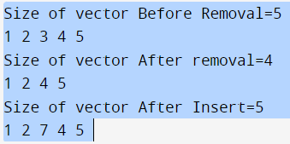
Dynamically Allocated Array STL template vector
#include<iostream>
#include<vector>
using namespace std;
int main(){
vector<int> v; //Vector Implementation
// Inserting Values in Vector
v.push_back(1); v.push_back(2); v.push_back(3);
v.push_back(4); v.push_back(5);
cout<<"Size of vector Before Removal="<<v.size() << "\n";
// Output Values of vector
for (int i=0; i<v.size(); i++)
cout << v[i] << " ";
v.erase(v.begin() + 2); // Remove 3rd element
cout<<"\nSize of vector After removal=" <<v.size()<< "\n";
// Output Values of vector
for (auto it : v) cout << it << " ";
v.insert(v.begin() + 2 , 7); // insert element at 3rd Location
cout << "\nSize of vector After Insert=" << v.size() << "\n"; for (auto it : v) cout << it << " ";
return 0;}

Slide 31
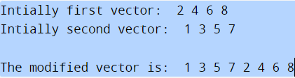
Dynamically Allocated Array STL template vector
#include<iostream>
#include<vector>
using namespace std;
int main()
{
vector<int> vec {2,4,6,8};
vector<int> vec2 {1,3,5,7};
cout<<"Intially first vector: ";
for(auto i=vec.begin(); i<vec.end(); i++)
{ cout<<" "<<*i; }
cout<<"\nIntially second vector: ";
for(auto i=vec2.begin(); i<vec2.end(); i++)
{ cout<<" "<<*i; }
//Inserting vec2 at the beginning of the vec vector
vec.insert(vec.begin(),vec2.begin(),vec2.end());
cout<<"\n\nThe modified vector is: ";
for(auto i=vec.begin(); i<vec.end(); i++)
{ cout<<" "<<*i; }
return 0;
}

